Slide 1
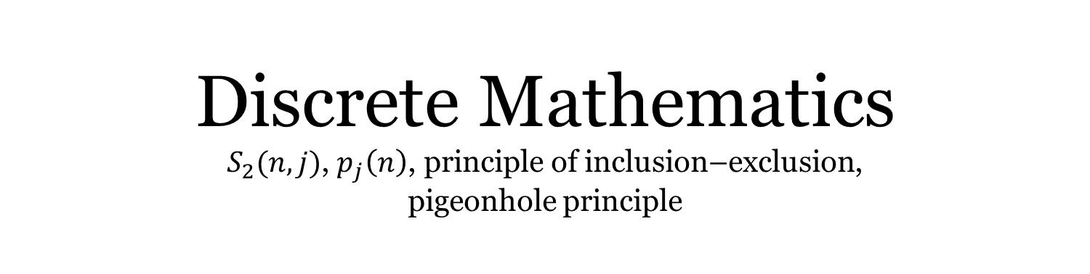
Discrete Mathematics $S_{2}(n,j)$, $p_{j}\left(n\right)$, principle of inclusion–exclusion, pigeonhole principle
Liangfeng Zhang
School of Information Science and Technology
ShanghaiTech University

Slide 2

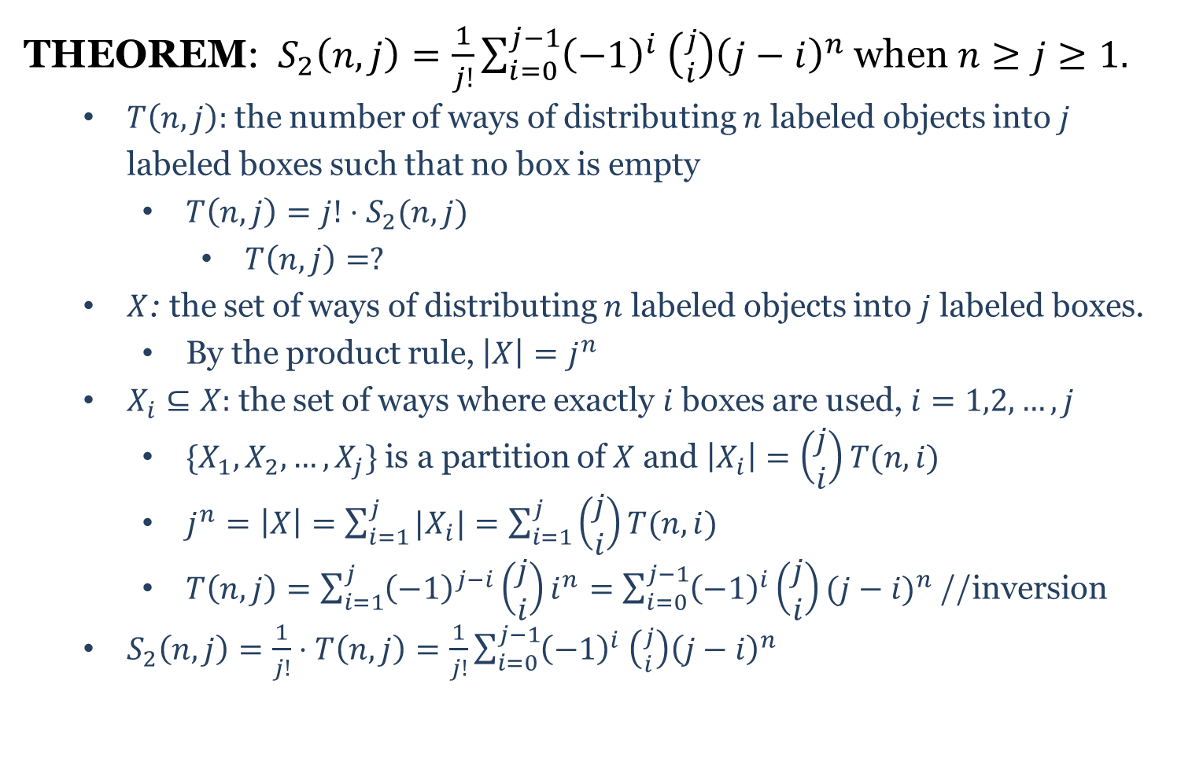
$$S_{2}(n,j)$$
THEOREM: $S_{2}\left(n,j\right)=\frac{1}{j!}\sum_{i=0}^{j−1}{{\left(−1\right)}^{i} \left({j \atop i}\right){\left(j−i\right)}^{n}}$ when $n≥j≥1.$
$T\left(n,j\right):$ the number of ways of distributing $n$ labeled objects into $j$ labeled boxes such that no box is empty
$T\left(n,j\right)=j!⋅S_{2}(n,j)$
$T\left(n,j\right)=?$
$X$: the set of ways of distributing $n$ labeled objects into $j$ labeled boxes.
By the product rule, $\left|X\right|=j^{n}$
$X_{i}⊆X:$ the set of ways where exactly $i$boxes are used, $i=1,2,…,j$
$\{X_{1},X_{2},…,X_{j}\}$ is a partition of $X$ and $\left|X_{i}\right|=\left(\begin{aligned}j \\ i\end{aligned}\right)T(n,i)$
$j^{n}=\left|X\right|=\sum_{i=1}^{j}{|X_{i}|}=\sum_{i=1}^{j}{\left(\begin{aligned}j \\ i\end{aligned}\right)T(n,i)}$
$T\left(n,j\right)=\sum_{i=1}^{j}{{\left(−1\right)}^{j−i}\left(\begin{aligned}j \\ i\end{aligned}\right)i^{n}}=\sum_{i=0}^{j−1}{{\left(−1\right)}^{i}\left(\begin{aligned}j \\ i\end{aligned}\right){(j−i)}^{n}}$ //inversion
$S_{2}\left(n,j\right)=\frac{1}{j!}⋅T\left(n,j\right)=\frac{1}{j!}\sum_{i=0}^{j−1}{{\left(−1\right)}^{i} \left({j \atop i}\right){\left(j−i\right)}^{n}}$

Slide 3

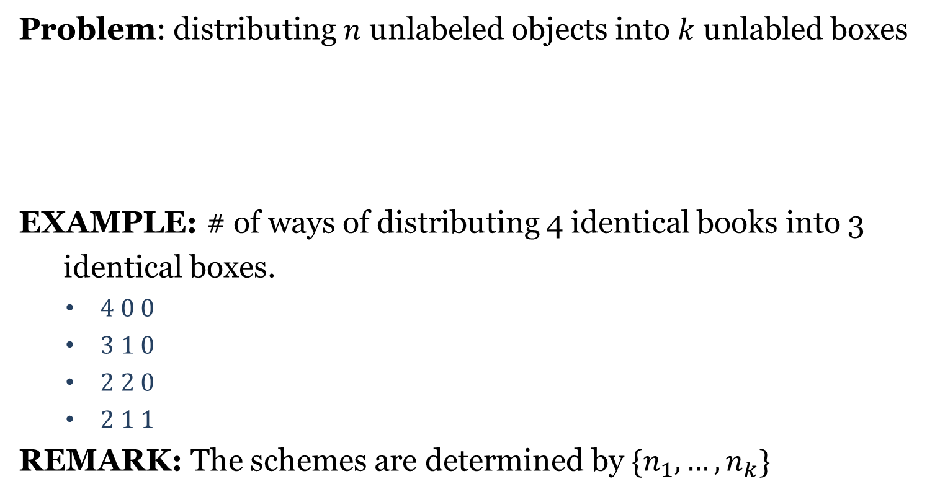


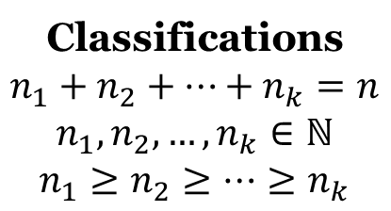




Type 4
Problem: distributing $n$ unlabeled objects into $k$ unlabled boxes
EXAMPLE: # of ways of distributing 4 identical books into 3
identical boxes.
$4 0 0$
$3 1 0$
$2 2 0$
$2 1 1$
REMARK: The schemes are determined by $\{n_{1},…,n_{k}\}$
$$⋯⋯$$
Classifications
$$n_{1}+n_{2}+⋯+n_{k}=n$$
$$n_{1},n_{2},…,n_{k}∈ℕ$$
$$n_{1}≥n_{2}≥⋯≥n_{k}$$
$$⋯⋯$$
$$n_{1}$$
$$n_{2}$$
$$n_{k}$$

Slide 4
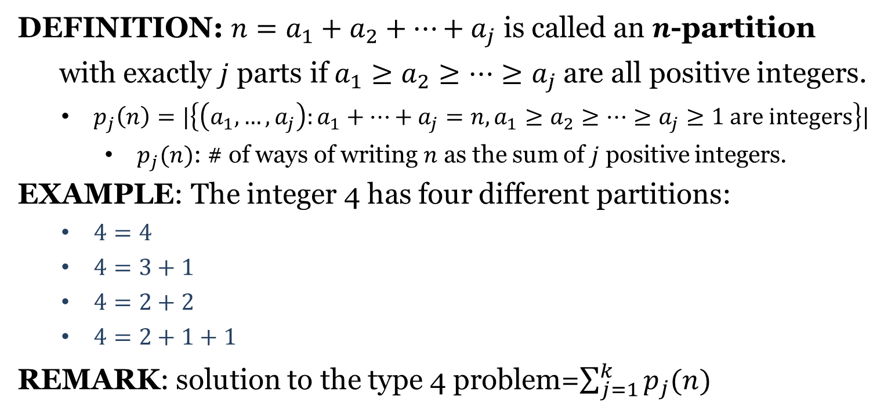
Partitions of Integers
DEFINITION: $n=a_{1}+a_{2}+⋯+a_{j}$ is called an $n$-partition
with exactly $j$ parts if $a_{1}≥a_{2}≥⋯≥a_{j}$ are all positive integers.
$p_{j}\left(n\right)=|\left\{\left(a_{1},…,a_{j}\right):a_{1}+⋯+a_{j}=n, a_{1}≥a_{2}≥⋯≥a_{j}≥1 are integers\right\}|$
$p_{j}(n)$: # of ways of writing $n$ as the sum of $j$ positive integers.
EXAMPLE: The integer 4 has four different partitions:
$4=4$
$4=3+1$
$4=2+2$
$4=2+1+1$
REMARK: solution to the type 4 problem=$\sum_{j=1}^{k}{p_{j}(n)}$

Slide 5
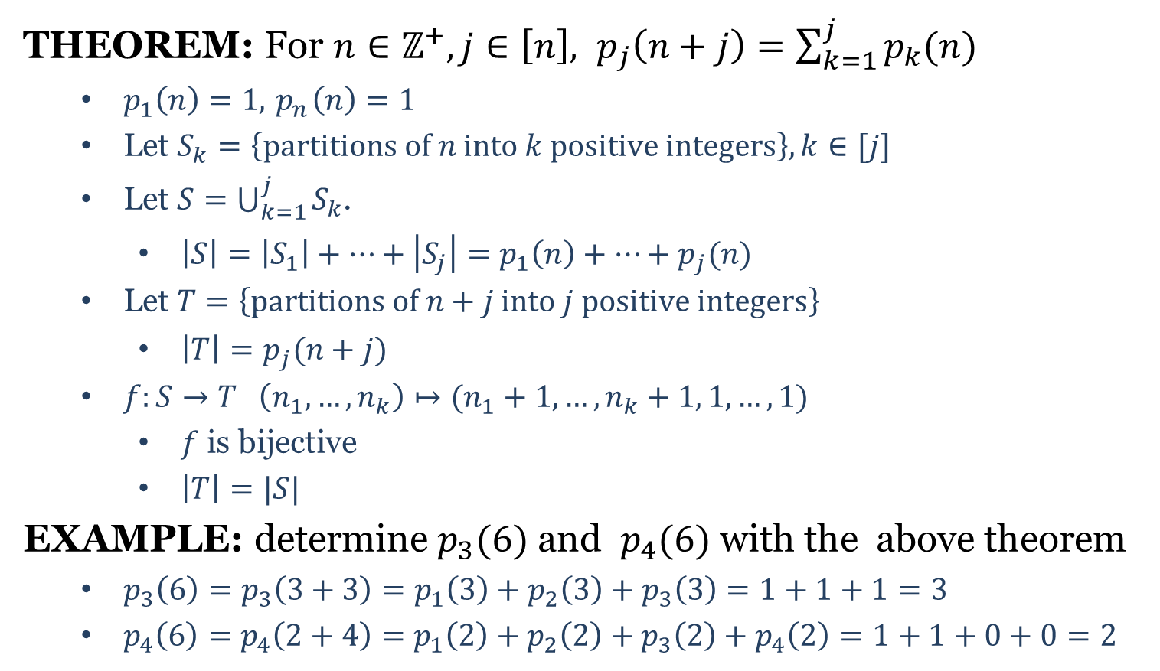

Partitions of Integers
THEOREM: For $n∈ℤ^{+}, j∈\left[n\right], p_{j}\left(n+j\right)=\sum_{k=1}^{j}{p_{k}(n)}$
$p_{1}\left(n\right)=1,{ p}_{n}\left(n\right)=1$
Let $S_{k}=\left\{partitions of n into k positive integers\right\}, k∈[j]$
Let $S=\bigcup_{k=1}^{j}{S_{k}}$.
$\left|S\right|=\left|S_{1}\right|+⋯+\left|S_{j}\right|=p_{1}\left(n\right)+⋯+p_{j}(n)$
Let $T=\left\{partitions of n+j into j positive integers\right\}$
$\left|T\right|=p_{j}(n+j)$
$f:S→T \left(n_{1},…,n_{k}\right)↦(n_{1}+1,…,n_{k}+1, 1,…,1)$
$f$ is bijective
$\left|T\right|=|S|$
EXAMPLE: determine $p_{3}(6)$ and $p_{4}(6)$ with the above theorem
$p_{3}\left(6\right)=p_{3}\left(3+3\right)=p_{1}\left(3\right)+p_{2}\left(3\right)+p_{3}\left(3\right)=1+1+1=3$
$p_{4}\left(6\right)=p_{4}\left(2+4\right)=p_{1}\left(2\right)+p_{2}\left(2\right)+p_{3}\left(2\right)+p_{4}\left(2\right)=1+1+0+0=2$
$$j−k$$

Slide 6
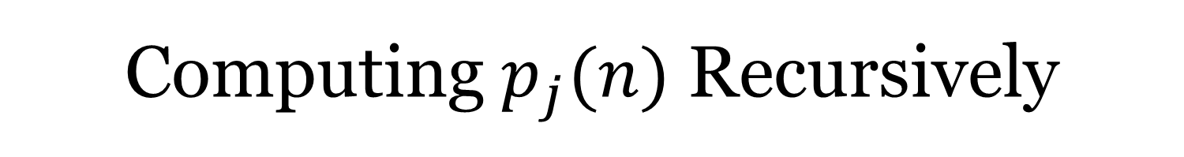
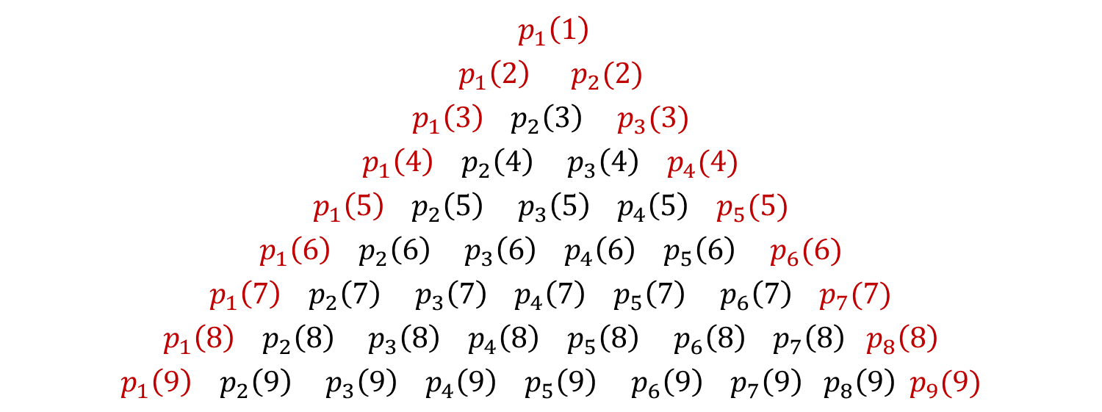
Computing $p_{j}(n)$ Recursively
$${ p}_{1}\left(1\right)$$
$$p_{1}\left(2\right) p_{2}(2)$$
$$p_{1}\left(3\right) p_{2}\left(3\right) p_{3}(3)$$
$$p_{1}\left(4\right) p_{2}\left(4\right) p_{3}\left(4\right) p_{4}(4)$$
$$p_{1}\left(5\right) p_{2}\left(5\right) p_{3}\left(5\right) p_{4}\left(5\right) p_{5}(5)$$
$$p_{1}\left(6\right) p_{2}\left(6\right) p_{3}\left(6\right) p_{4}\left(6\right) p_{5}\left(6\right) p_{6}(6)$$
$$p_{1}\left(7\right) p_{2}\left(7\right) p_{3}\left(7\right) p_{4}\left(7\right) p_{5}\left(7\right) p_{6}\left(7\right) p_{7}(7)$$
$$p_{1}\left(8\right) p_{2}\left(8\right) p_{3}\left(8\right) p_{4}\left(8\right) p_{5}\left(8\right) p_{6}\left(8\right) p_{7}\left(8\right) p_{8}\left(8\right)$$
$$p_{1}\left(9\right) p_{2}\left(9\right) p_{3}\left(9\right) p_{4}\left(9\right) p_{5}\left(9\right) p_{6}\left(9\right) p_{7}\left(9\right) p_{8}\left(9\right) p_{9}(9)$$

Slide 8
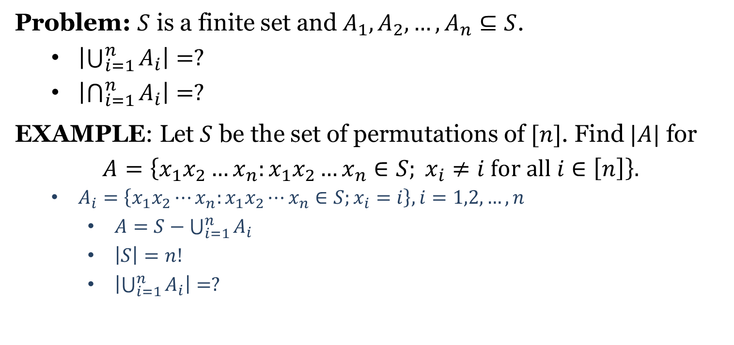
Principle of Inclusion–Exclusion
Problem: $S$ is a finite set and $A_{1},A_{2},…,A_{n}⊆S$.
$\left|\bigcup_{i=1}^{n}{A_{i}}\right|=?$
$\left|\bigcap_{i=1}^{n}{A_{i}}\right|=?$
EXAMPLE: Let $S$ be the set of permutations of $[n]$. Find $|A|$ for
$$A=\left\{x_{1}x_{2}…x_{n}:x_{1}x_{2}…x_{n}∈S; x_{i}≠i for all i∈\left[n\right]\right\}.$$
$A_{i}=\left\{x_{1}x_{2}⋯x_{n}:x_{1}x_{2}⋯x_{n}∈S;x_{i}=i\right\}, i=1,2,…,n$
$A=S−\bigcup_{i=1}^{n}{A_{i}}$
$\left|S\right|=n!$
$\left|\bigcup_{i=1}^{n}{A_{i}}\right|=?$

Slide 9
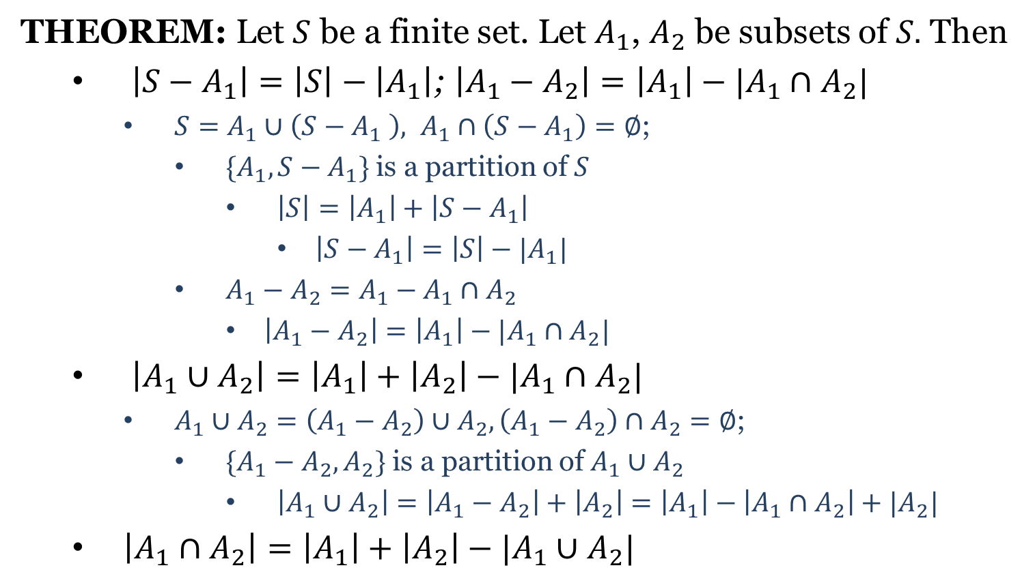
Principle of IE (Two Sets)
THEOREM: Let $S$ be a finite set. Let $A_{1}$, $A_{2}$ be subsets of $S.$ Then
$\left|S−A_{1}\right|=\left|S\right|−\left|A_{1}\right|$; $\left|A_{1}−A_{2}\right|=\left|A_{1}\right|−|A_{1}∩A_{2}|$
$S=A_{1}∪\left(S−A_{1} \right), A_{1}∩\left(S−A_{1}\right)=∅$;
$\{A_{1},S−A_{1}\}$ is a partition of $S$
$\left|S\right|=\left|A_{1}\right|+\left|S−A_{1}\right|$
$\left|S−A_{1}\right|=\left|S\right|−|A_{1}|$
$A_{1}−A_{2}=A_{1}−A_{1}∩A_{2}$
$\left|A_{1}−A_{2}\right|=\left|A_{1}\right|−|A_{1}∩A_{2}|$
$\left|A_{1}∪A_{2}\right|=\left|A_{1}\right|+\left|A_{2}\right|−|A_{1}∩A_{2}|$
$A_{1}∪A_{2}=\left(A_{1}−A_{2}\right)∪A_{2}, \left(A_{1}−A_{2}\right)∩A_{2}=∅$;
$\{A_{1}−A_{2},A_{2}\}$ is a partition of $A_{1}∪A_{2}$
$\left|A_{1}∪A_{2}\right|=\left|A_{1}−A_{2}\right|+\left|A_{2}\right|=\left|A_{1}\right|−\left|A_{1}∩A_{2}\right|+|A_{2}|$
$\left|A_{1}∩A_{2}\right|=\left|A_{1}\right|+\left|A_{2}\right|−|A_{1}∪A_{2}|$

Slide 10
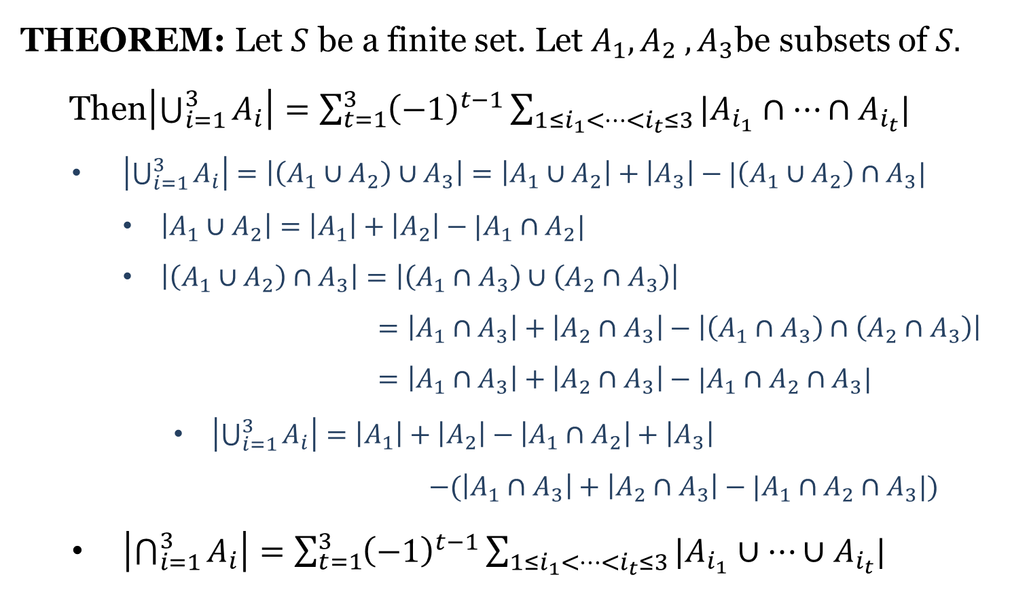
Principle of IE (Three Sets)
THEOREM: Let $S$ be a finite set. Let $A_{1}, A_{2} ,A_{3}$be subsets of $S.$
Then$\left|\bigcup_{i=1}^{3}{A_{i}}\right|=\sum_{t=1}^{3}{{\left(−1\right)}^{t−1}}\sum_{1≤i_{1}<⋯<i_{t}≤3}{|A_{i_{1}}∩⋯∩A_{i_{t}}|}$
$\left|\bigcup_{i=1}^{3}{A_{i}}\right|=\left|\left(A_{1}∪A_{2}\right)∪A_{3}\right|=\left|A_{1}∪A_{2}\right|+\left|A_{3}\right|−|\left(A_{1}∪A_{2}\right)∩A_{3}|$
$\left|A_{1}∪A_{2}\right|=\left|A_{1}\right|+\left|A_{2}\right|−|A_{1}∩A_{2}|$
$\left|\left(A_{1}∪A_{2}\right)∩A_{3}\right|=\left|\left(A_{1}∩A_{3}\right)∪\left(A_{2}∩A_{3}\right)\right|$
$=\left|A_{1}∩A_{3}\right|+\left|A_{2}∩A_{3}\right|−\left|\left(A_{1}∩A_{3}\right)∩\left(A_{2}∩A_{3}\right)\right|$
$=\left|A_{1}∩A_{3}\right|+\left|A_{2}∩A_{3}\right|−|A_{1}∩A_{2}∩A_{3}|$
$\left|\bigcup_{i=1}^{3}{A_{i}}\right|=\left|A_{1}\right|+\left|A_{2}\right|−\left|A_{1}∩A_{2}\right|+\left|A_{3}\right|$
$−(\left|A_{1}∩A_{3}\right|+\left|A_{2}∩A_{3}\right|−|A_{1}∩A_{2}∩A_{3}|)$
$\left|\bigcap_{i=1}^{3}{A_{i}}\right|=\sum_{t=1}^{3}{{\left(−1\right)}^{t−1}}\sum_{1≤i_{1}<⋯<i_{t}≤3}{|A_{i_{1}}∪⋯∪A_{i_{t}}|}$

Slide 11

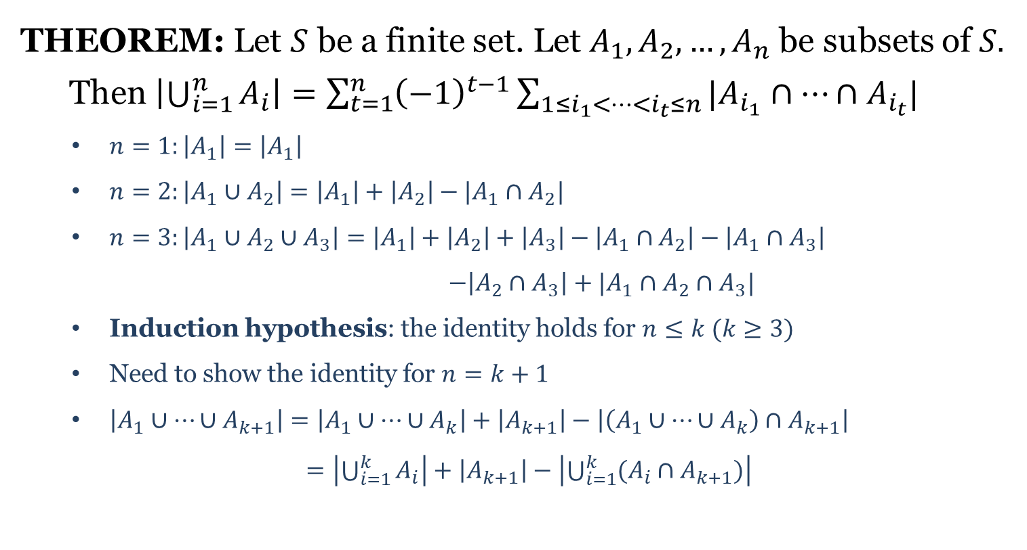
Principle of IE ($n$ Sets)
THEOREM: Let $S$ be a finite set. Let $A_{1},A_{2},…,A_{n}$ be subsets of $S.$
Then $\left|\bigcup_{i=1}^{n}{A_{i}}\right|=\sum_{t=1}^{n}{{\left(−1\right)}^{t−1}\sum_{1≤i_{1}<⋯<i_{t}≤n}{|A_{i_{1}}∩⋯∩A_{i_{t}}|}}$
$n=1:\left|A_{1}\right|=\left|A_{1}\right|$
$n=2:\left|A_{1}∪A_{2}\right|=\left|A_{1}\right|+\left|A_{2}\right|−|A_{1}∩A_{2}|$
$n=3:\left|A_{1}∪A_{2}∪A_{3}\right|=\left|A_{1}\right|+\left|A_{2}\right|+\left|A_{3}\right|−\left|A_{1}∩A_{2}\right|−\left|A_{1}∩A_{3}\right|$
$−\left|A_{2}∩A_{3}\right|+|A_{1}∩A_{2}∩A_{3}|$
Induction hypothesis: the identity holds for $n≤k (k≥3)$
Need to show the identity for $n=k+1$
$\left|A_{1}∪⋯∪A_{k+1}\right|=\left|A_{1}∪⋯∪A_{k}\right|+\left|A_{k+1}\right|−\left|\left(A_{1}∪⋯∪A_{k}\right)∩A_{k+1}\right|$
$=\left|\bigcup_{i=1}^{k}{A_{i}}\right|+\left|A_{k+1}\right|−\left|\bigcup_{i=1}^{k}{(A_{i}∩A_{k+1})}\right|$

Slide 12
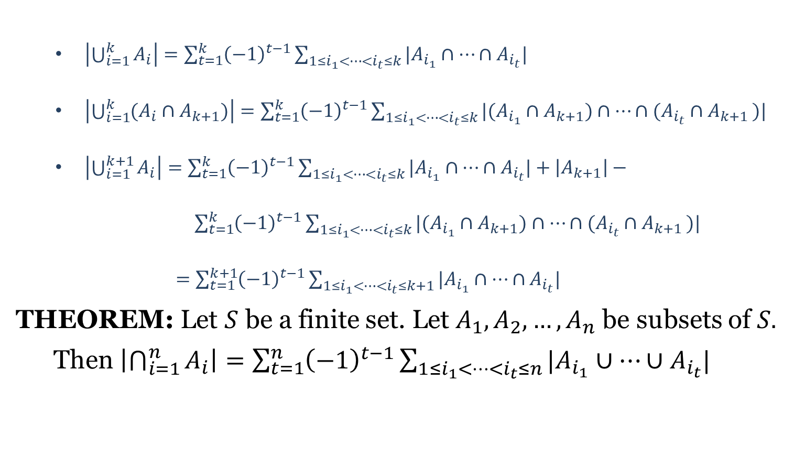
Principle of IE ($n$ Sets)
$\left|\bigcup_{i=1}^{k}{A_{i}}\right|=\sum_{t=1}^{k}{{\left(−1\right)}^{t−1}\sum_{1≤i_{1}<⋯<i_{t}≤k}{|A_{i_{1}}∩⋯∩A_{i_{t}}|}}$
$\left|\bigcup_{i=1}^{k}{(A_{i}∩A_{k+1})}\right|=\sum_{t=1}^{k}{{\left(−1\right)}^{t−1}\sum_{1≤i_{1}<⋯<i_{t}≤k}{|(A_{i_{1}}∩A_{k+1})∩⋯∩(A_{i_{t}}∩A_{k+1 })|}}$
$\left|\bigcup_{i=1}^{k+1}{A_{i}}\right|=\sum_{t=1}^{k}{{\left(−1\right)}^{t−1}\sum_{1≤i_{1}<⋯<i_{t}≤k}{|A_{i_{1}}∩⋯∩A_{i_{t}}|}}+\left|A_{k+1}\right|−$
$\sum_{t=1}^{k}{{\left(−1\right)}^{t−1}\sum_{1≤i_{1}<⋯<i_{t}≤k}{|(A_{i_{1}}∩A_{k+1})∩⋯∩(A_{i_{t}}∩A_{k+1 })|}}$
$=\sum_{t=1}^{k+1}{{\left(−1\right)}^{t−1}\sum_{1≤i_{1}<⋯<i_{t}≤k+1}{|A_{i_{1}}∩⋯∩A_{i_{t}}|}}$
THEOREM: Let $S$ be a finite set. Let $A_{1},A_{2},…,A_{n}$ be subsets of $S.$
Then $\left|\bigcap_{i=1}^{n}{A_{i}}\right|=\sum_{t=1}^{n}{{\left(−1\right)}^{t−1}\sum_{1≤i_{1}<⋯<i_{t}≤n}{|A_{i_{1}}∪⋯∪A_{i_{t}}|}}$

Slide 13
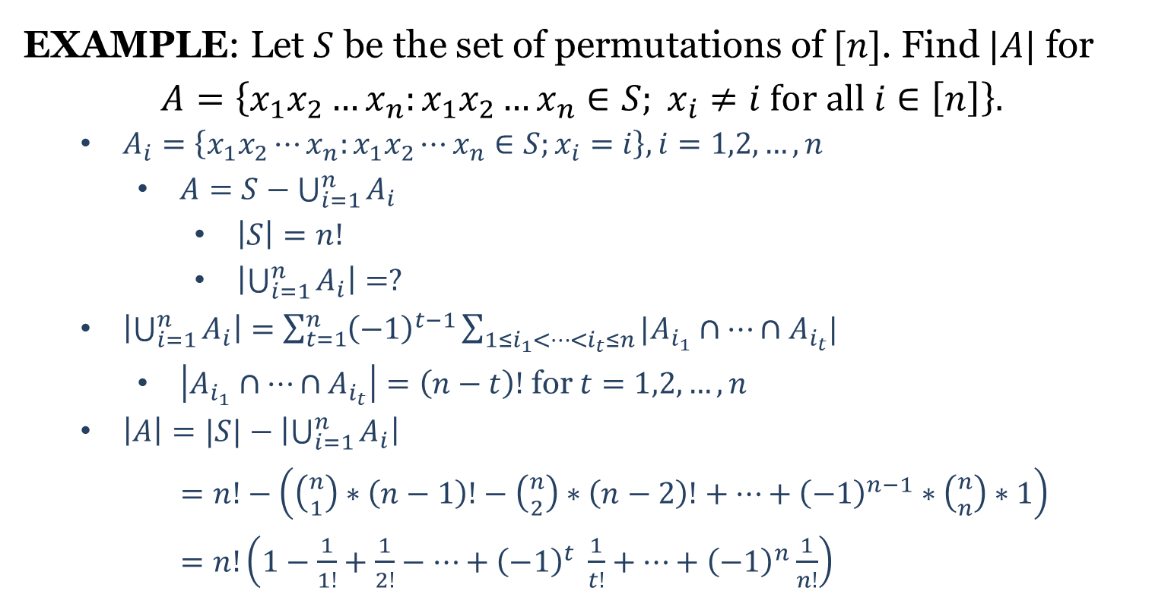
Principle of Inclusion-Exclusion
EXAMPLE: Let $S$ be the set of permutations of $[n]$. Find $|A|$ for
$$A=\left\{x_{1}x_{2}…x_{n}:x_{1}x_{2}…x_{n}∈S; x_{i}≠i for all i∈\left[n\right]\right\}.$$
$A_{i}=\left\{x_{1}x_{2}⋯x_{n}:x_{1}x_{2}⋯x_{n}∈S;x_{i}=i\right\}, i=1,2,…,n$
$A=S−\bigcup_{i=1}^{n}{A_{i}}$
$\left|S\right|=n!$
$\left|\bigcup_{i=1}^{n}{A_{i}}\right|=?$
$\left|\bigcup_{i=1}^{n}{A_{i}}\right|=\sum_{t=1}^{n}{{\left(−1\right)}^{t−1}\sum_{1≤i_{1}<⋯<i_{t}≤n}{|A_{i_{1}}∩⋯∩A_{i_{t}}|}}$
$\left|A_{i_{1}}∩⋯∩A_{i_{t}}\right|=\left(n−t\right)!$ for $t=1,2,…,n$
$\left|A\right|=|S|−\left|\bigcup_{i=1}^{n}{A_{i}}\right|$
$=n!−\left(\left({n \atop 1}\right)∗\left(n−1\right)!−\left({n \atop 2}\right)∗\left(n−2\right)!+⋯+{\left(−1\right)}^{n−1}∗\left({n \atop n}\right)∗1\right)$
$=n!\left(1−\frac{1}{1!}+\frac{1}{2!}−⋯+{\left(−1\right)}^{t} \frac{1}{t!}+⋯+{\left(−1\right)}^{n}\frac{1}{n!}\right)$

Slide 15
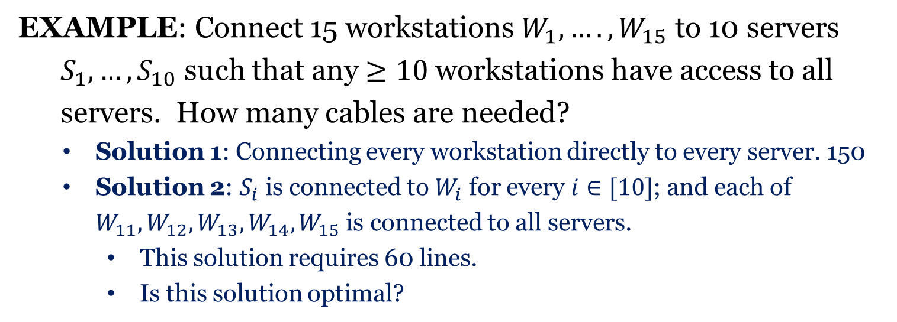
Pigeonhole Principle
EXAMPLE: Connect 15 workstations $W_{1},….,W_{15}$ to 10 servers
$S_{1},…,S_{10}$ such that any $≥10$workstations have access to all
servers. How many cables are needed?
Solution 1: Connecting every workstation directly to every server. 150
Solution 2: $S_{i}$ is connected to $W_{i}$ for every $i∈[10]$; and each of $W_{11},W_{12},W_{13}, W_{14}, W_{15}$ is connected to all servers.
This solution requires 60 lines.
Is this solution optimal?

Slide 16
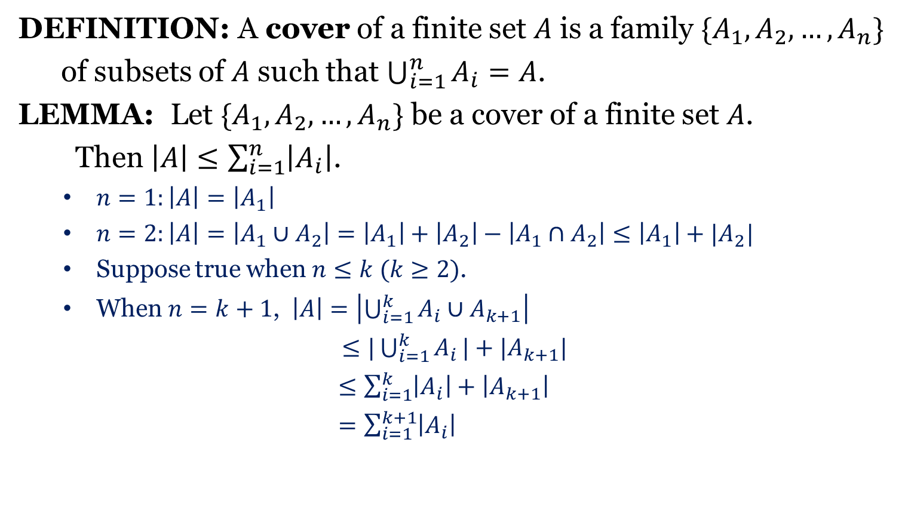
Cover
DEFINITION: A cover of a finite set $A$ is a family $\{A_{1},A_{2},…,A_{n}\}$
of subsets of $A$ such that $\bigcup_{i=1}^{n}{A_{i}=A}$.
LEMMA: Let $\{A_{1},A_{2},…,A_{n}\}$ be a cover of a finite set $A$.
Then $\left|A\right|≤\sum_{i=1}^{n}{\left|A_{i}\right|}$.
$n=1:\left|A\right|=\left|A_{1}\right|$
$n=2:\left|A\right|=\left|A_{1}∪A_{2}\right|=\left|A_{1}\right|+\left|A_{2}\right|−\left|A_{1}∩A_{2}\right|≤\left|A_{1}\right|+|A_{2}|$
Suppose true when $n≤k (k≥2)$.
When $n=k+1$, $\left|A\right|=\left|\bigcup_{i=1}^{k}{A_{i}}∪A_{k+1}\right|$
$≤|\bigcup_{i=1}^{k}{A_{i}}|+|A_{k+1}|$
$≤\sum_{i=1}^{k}{\left|A_{i}\right|}+\left|A_{k+1}\right|$
$=\sum_{i=1}^{k+1}{\left|A_{i}\right|}$

Slide 17
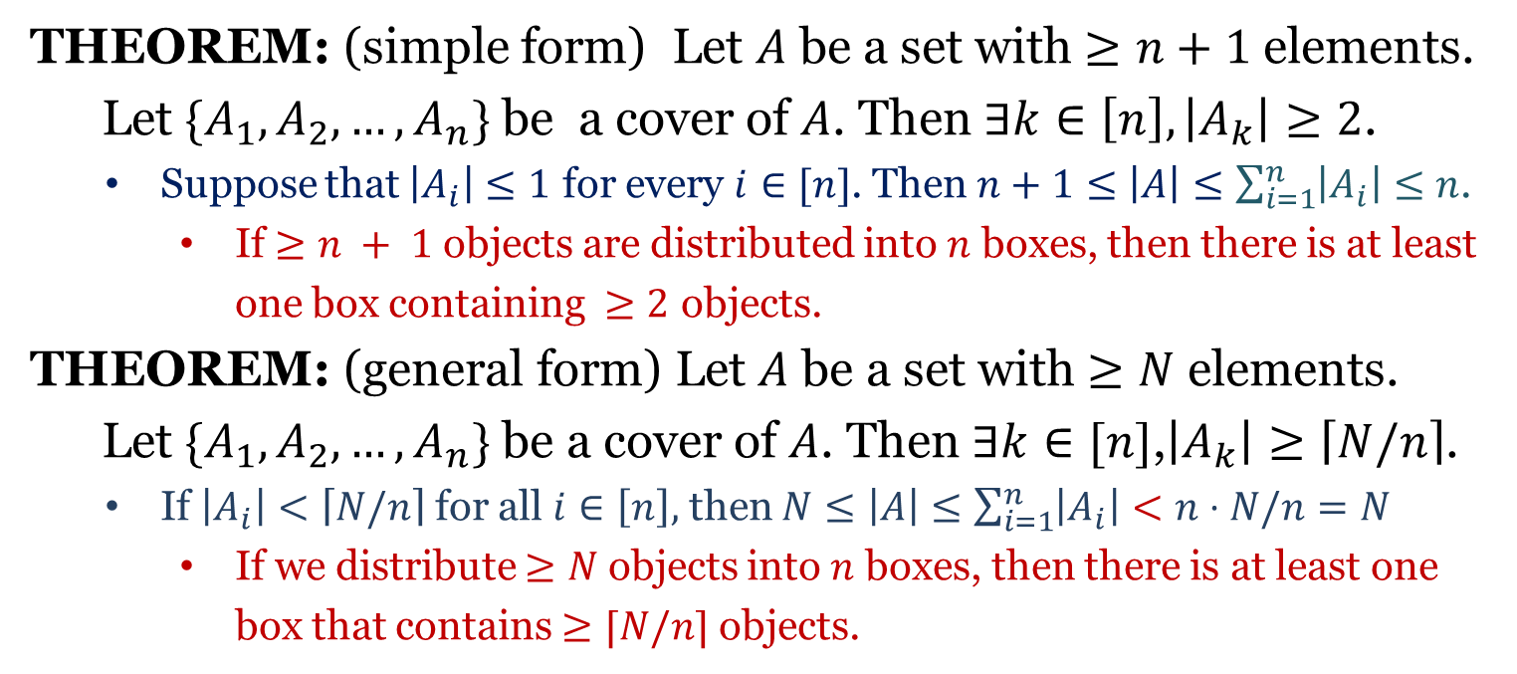
Pigeonhole Principle
THEOREM: (simple form) Let $A$ be a set with $≥n+1$ elements.
Let $\{A_{1},A_{2},…,A_{n}\}$ be a cover of $A$. Then $∃k∈\left[n\right],\left|A_{k}\right|≥2$.
Suppose that $\left|A_{i}\right|≤1$ for every $i∈[n]$. Then $n+1≤\left|A\right|≤\sum_{i=1}^{n}{\left|A_{i}\right|}≤n$.
If $≥n + 1$ objects are distributed into $n$ boxes, then there is at least one box containing $≥2$ objects.
THEOREM: (general form) Let $A$ be a set with $≥N$ elements.
Let $\{A_{1},A_{2},…,A_{n}\}$ be a cover of $A$. Then $∃k∈[n]$,$\left|A_{k}\right|≥\left\lceil N/n\right\rceil$.
If $\left|A_{i}\right|<\left\lceil N/n\right\rceil$ for all $i∈\left[n\right],$ then $N≤\left|A\right|≤\sum_{i=1}^{n}{\left|A_{i}\right|}<n⋅N/n=N$
If we distribute $≥N$ objects into $n$ boxes, then there is at least one box that contains $≥⌈N/n⌉$ objects.

